Slide 1
Boolean Algebra

Slide 2
Index
Fundamental Definitions
Variable
Function
Complement
Literals
Product and sum
Canonical forms
Sum-of-Products SOP
Product-of-Sums POS
Axioms and Theorems
Axioms
Theorems of one variable
Theorems of several variables
Perfect Induction
Simplifying Equations
Schematic
Programmable Logic Array PLA
Multiple-output circuits
Multi-level Logic
Bubble Pushing
Beyond 0 and 1: X and Z

Slide 3
Boolean Variable and Functions
Let X be a certain discreet variable, we call boolean variable any discreet variable that can assume only two values:
X = 0 False
X = 1 True
If we have the boolean variables X₁, X₂, . . ., X_{n}
f (X₁, X₂, . . . , X_{n}) is called a boolean function
it can assume only the values 0 and 1
associates a boolean value to every element in its domain
The domain of a function of n-variables is composed of all the 2^{n} combinations of their values
domain’s elements are countable
Two functions are equivalent if they assume the same value for any combination of their variable's values

Slide 4
Complement, literals, product and sum
_
The complement of a variable A is its inverse A
A is the true form
A is the complementary form
Literals are the elements that make up a boolean expression
considering f(A, B): a logical function with two binary variables A and B
f(A, B) = A + B has 2 literals
f(A, B) = AB + BA has 4 literals
The AND of one or more literals is called product (or implicant)
AB, ABC, and B are all implicants
A minterm is an implicant involving all the inputs to the function
ABC is a minterm for a function of the three variables A, B, and C
The OR of one or more literals is called a sum
A maxterm is a sum involving all the inputs to the function
A + B + C is a maxterm for a function of the three variables A, B, and C
_
_
_

Slide 5
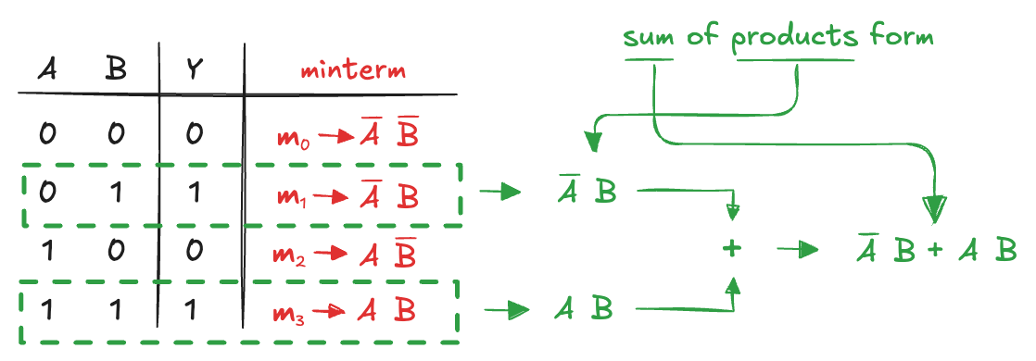
Sum-of-Products Form (SOP) (1)
A truth table of N inputs contains 2^{N} rows: one for each possible value of the inputs
We can associate each row with a minterm that is TRUE for that row
We can write the boolean equation by summing each of the minterms for which the output is TRUE
This is called the sum-of-products (SOP) canonical form of a function: it is the sum (OR) of products (AND)
In sigma notation:
f(A,B) = 𝛴(m₁, m₃)

Slide 6
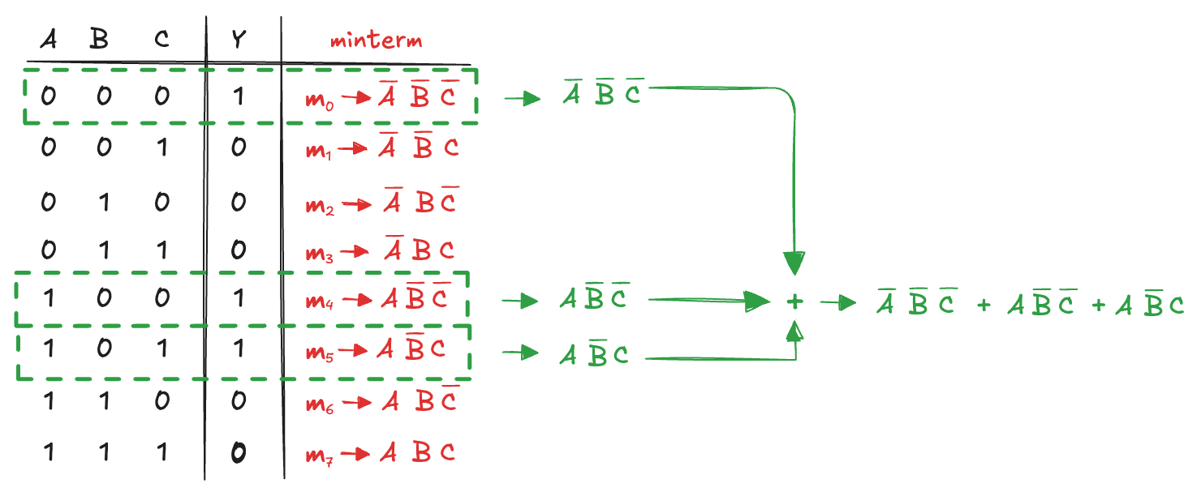
Sum-of-Products Form (SOP) (2)
The sum-of-products form provides a boolean equation for any truth table with any number of variables:
Unfortunately, sum-of-products form does not necessarily generate the simplest equation

Slide 7
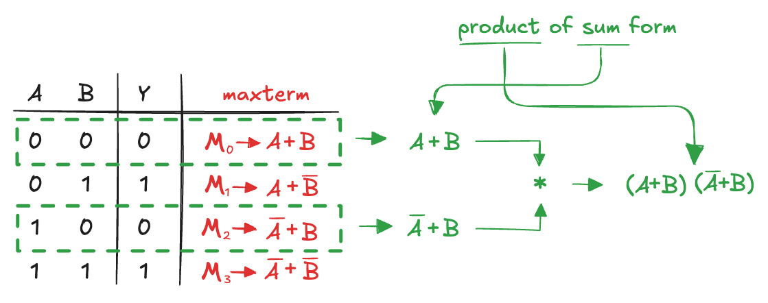
Product-of-Sums Form (POS)
An alternative way of expressing boolean functions
We associate each row with a maxterm that is FALSE for that row
We can write the boolean equation as the AND of each of the maxterms for which the output is FALSE
This is called the product-of-sum (POS) canonical form of a function
In pi notation:
f(A,B) = π(M₀, M₂)
POS form does not necessarily generate the simplest equation
_

Slide 8
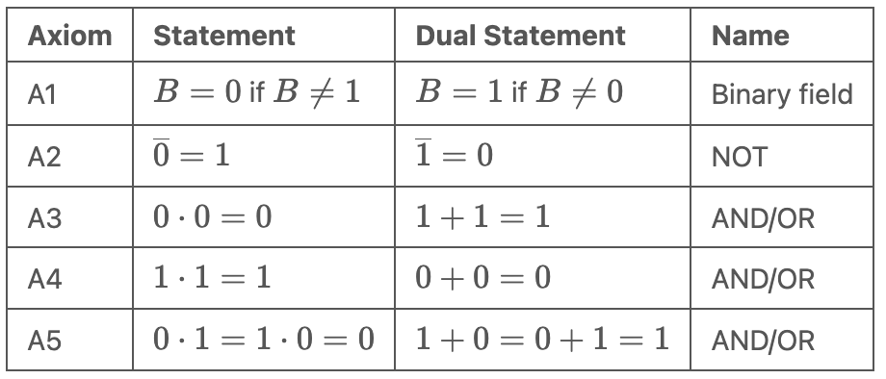
Axioms
Canonical forms ensure correct representation, but not the simplest implementation.
We can use boolean algebra to simplify boolean equations
rules are much like those of ordinary algebra
in some cases, simpler, because variables have only two possible values
Five axioms define Boolean variables and the operations NOT, AND, OR:
Principle of Duality: Interchanging 0 and ,1 AND and OR leaves the statement valid

Slide 9
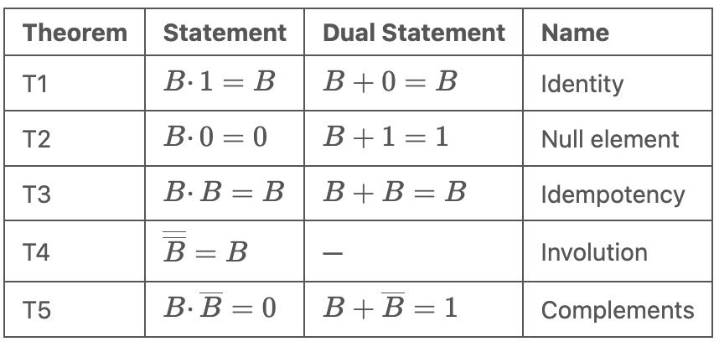
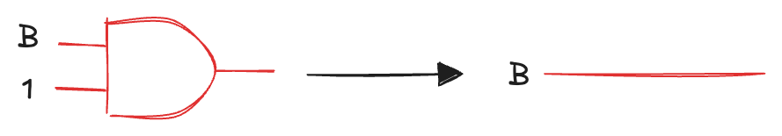
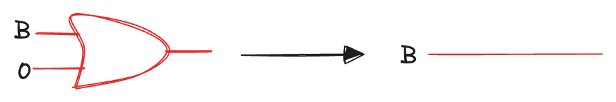
Theorems of One Variable (1)
Describe how to simplify equations involving one variable:
T1 Identity theorem
if one input of an AND gate is 1, the AND gate can be removed
if one input of an OR gate is set to 0, the OR gate can be removed
Gates cost money, power, and delay, so replacing it with a wire is beneficial!

Slide 10
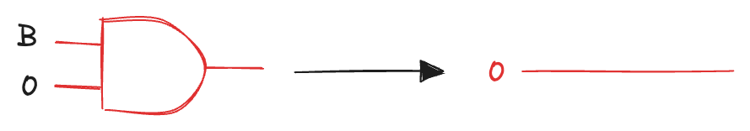
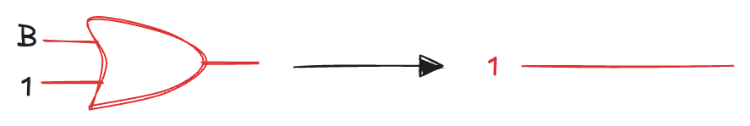
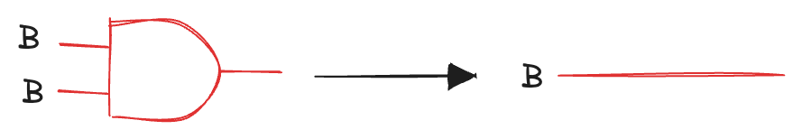
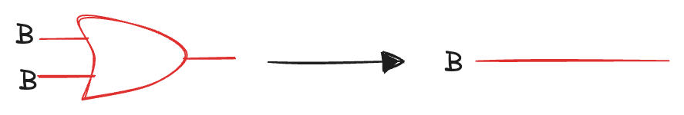
Theorems of One Variable (2)
T2 Null element theorem
B AND 0 is always equal to 0 (null element for the AND operation because it nullifies the effect of any other input)
B OR 1 is always equal to 1 (null element for the OR operation)
T3 Idempotency theorem
a variable AND/OR itself is equal to just itself
idem (same) and potent (power)
permits replacing a gate with a wire

Slide 11
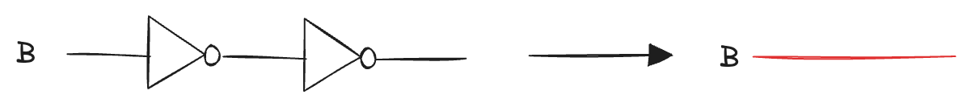
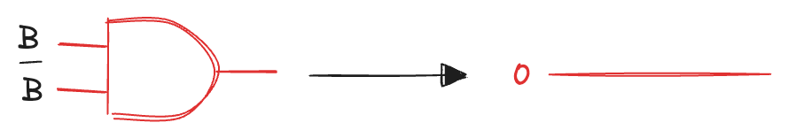
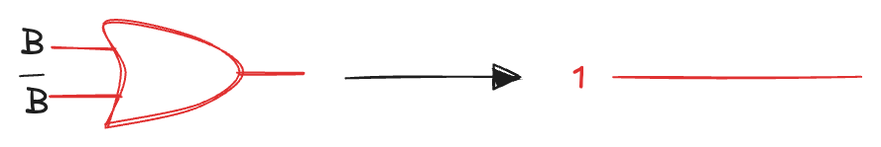
Theorems of One Variable (3)
T4 Involution theorem
complementing a variable twice results in the original variable
two inverters logically cancel each other out and are logically equivalent to a wire
T5 Complement theorem
a variable AND its complement is 0 (because one of them must be 0)
a variable OR its complement is 1 (because one of them must be 1)

Slide 12
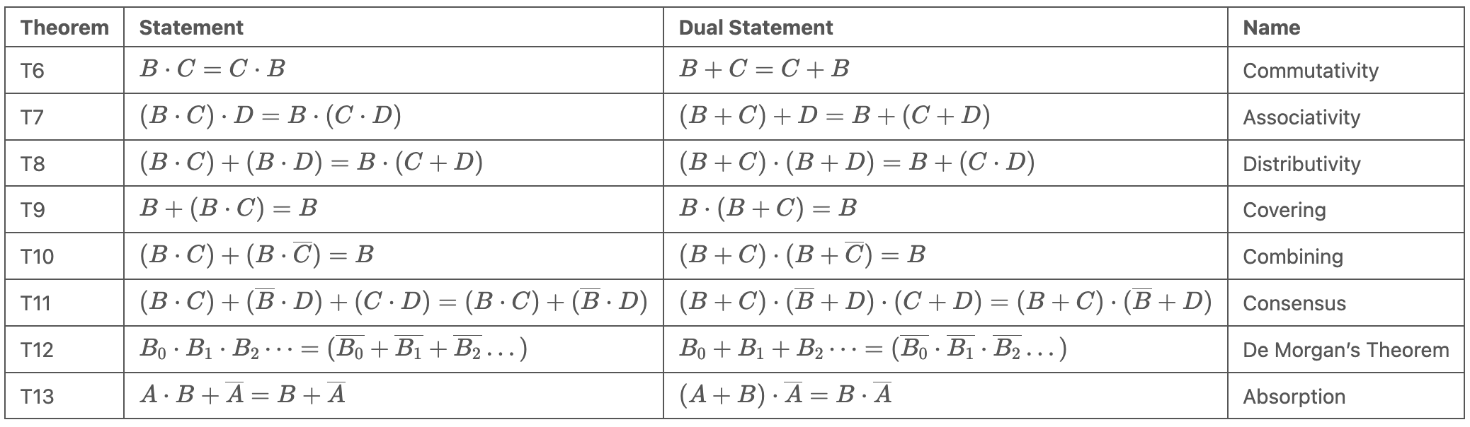
Theorems of Several Variables (1)
Describe how to simplify equations involving more than one variable:

Slide 13



Theorems of Several Variables (2)
T6 Commutativity
the order of the inputs does not matter
we can rearrange terms without changing the logic of the expression
T7 Associativity
the grouping of inputs does not matter
We can simplify expressions without worrying about how the terms are grouped
T8 Distributivity theorem
AND distributes over OR, OR distributes over AND
different from traditional algebra: addition does not distribute over multiplication
(b + c) × (b + d) ≠ b + (c × d)
allows us to factor expressions or to expand them

Slide 14

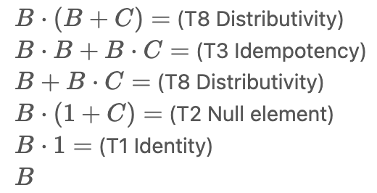

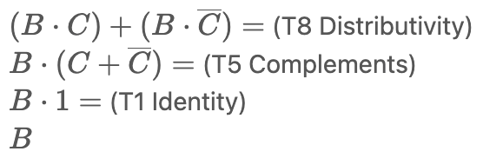
Theorems of Several Variables (3)
T9 Covering
T10 Combining

Slide 15

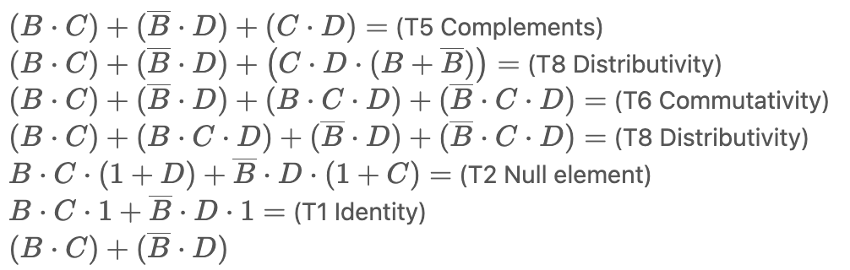
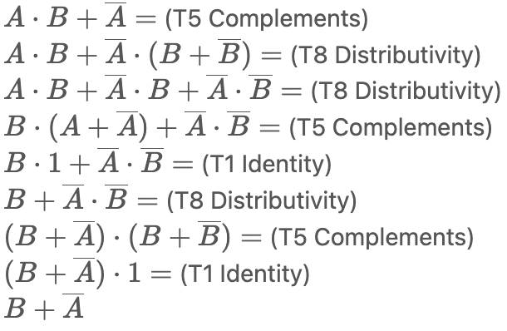
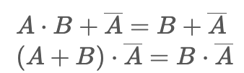
Theorems of Several Variables (4)
T11 Consensus theorems
T12 Absorption

Slide 16
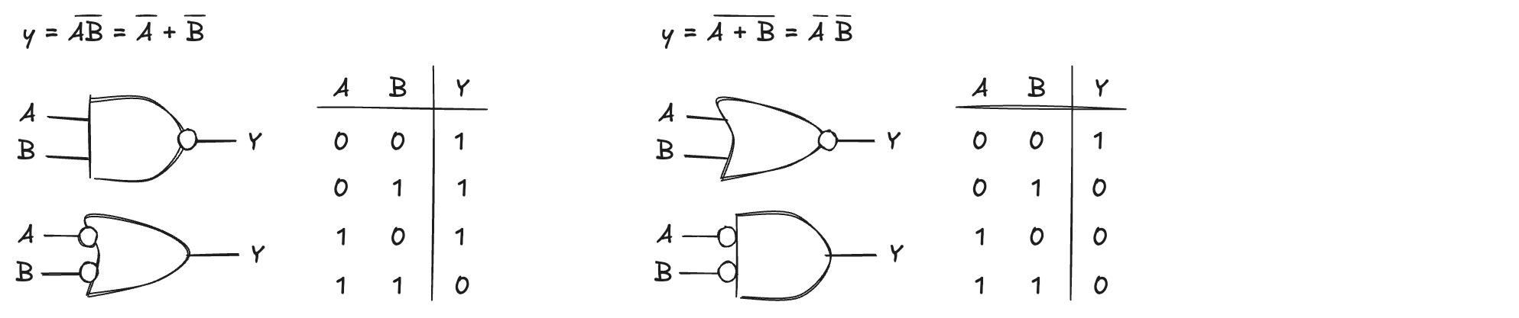
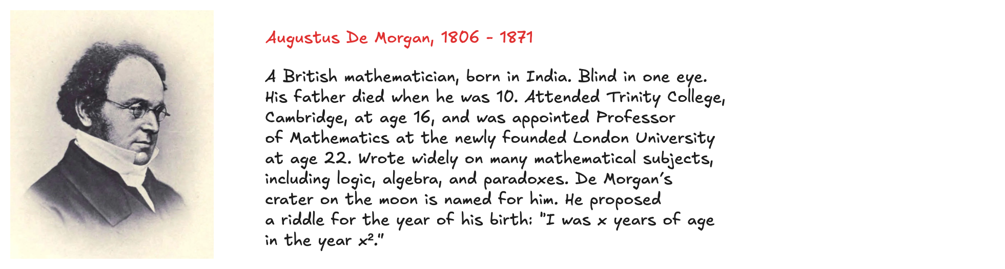
T13 De Morgan’s Theorem
Complement of the product is equal to the sum of the complements
NAND gate = OR gate with inverted inputs
Complement of the sum is equal to the product of the complements
NOR gate = AND gate with inverted inputs
The inversion circle is called a bubble
Intuitively: we can imagine that “pushing” a bubble through the gate causes it to come out at the other side and flips the body of the gate from AND to OR or vice versa

Slide 17
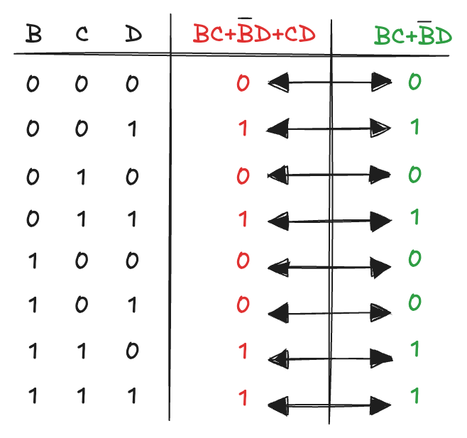
Perfect induction
Proof of theorems with a finite number of variables are easy: Just show that the theorem holds for all possible values of these variables
Example: proving the T11 Consensus theorem using perfect induction:
Because the two formulation are equal for all cases, the theorem is proved!

Slide 18



Simplifying Expressions (1)
The theorems are not only useful for proving properties but also provide a systematic way to simplify Boolean expressions
Simplification is at the heart of digital design:
transforms truth-table–derived SOP or POS forms (often large and unwieldy)
into compact implementations using the fewest possible gates
results in lower cost, less power consumption, and shorter delay
Example
using the Combining theorem (T10):
In general, multiple steps may be required for complex equations
Basic principle: combine terms using:
where P may be any expression
How far can an equation be simplified?
a sum-of-products form is minimal if it uses the fewest possible products
if several equations have the same number of products, the minimal one has the fewest literals
a prime product cannot be further combined to reduce literals
all product in a minimal expression are prime

Slide 19
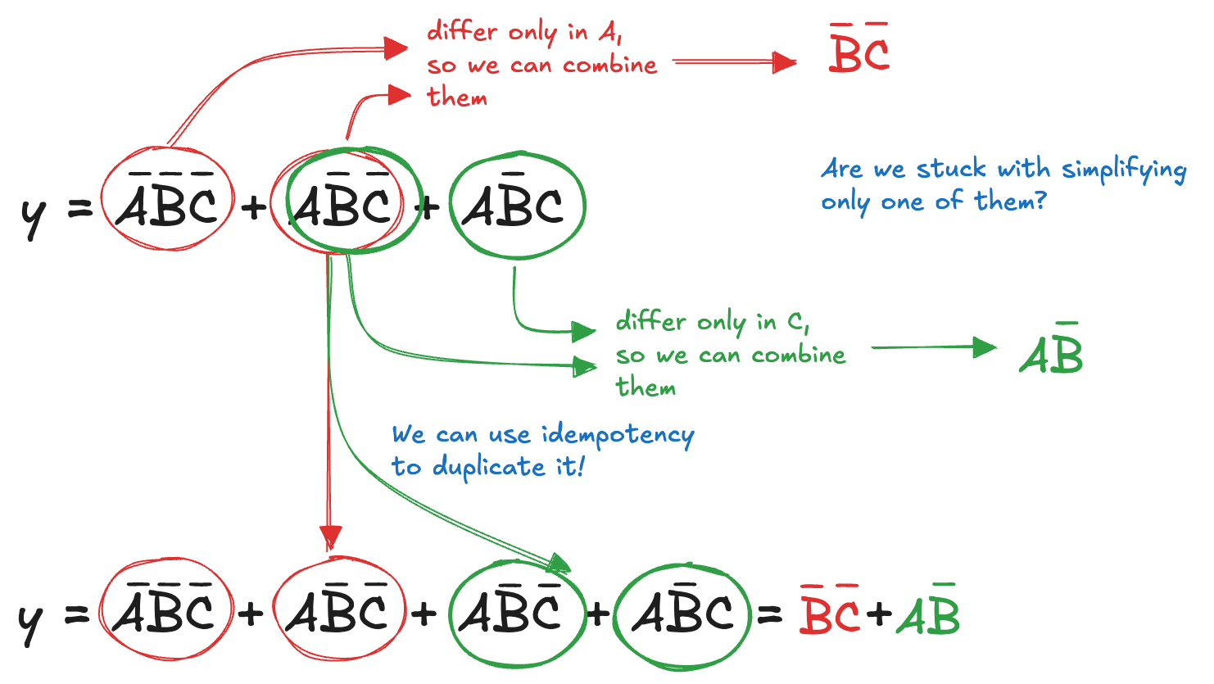
Simplifying Expressions (2)

Slide 20
Simplifying Expressions (3)
Why bother simplifying a Boolean equation if it remains logically equivalent?
reduction of the number of gates
make the circuit smaller, cheaper, and possibly faster
Notice that simplifying boolean equations with theorems can take some trial and error, later we describes a methodical technique (Karnaugh maps) that makes the process easier

Slide 21
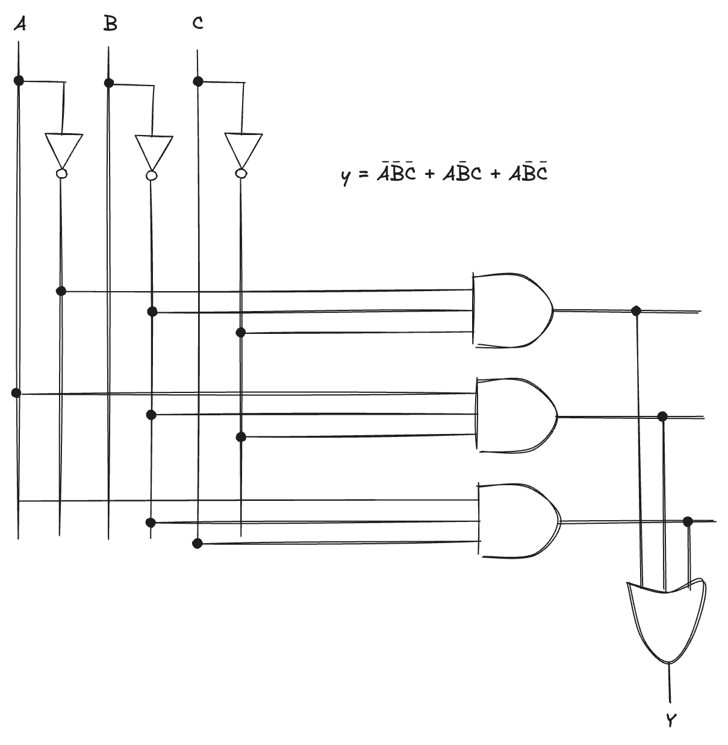
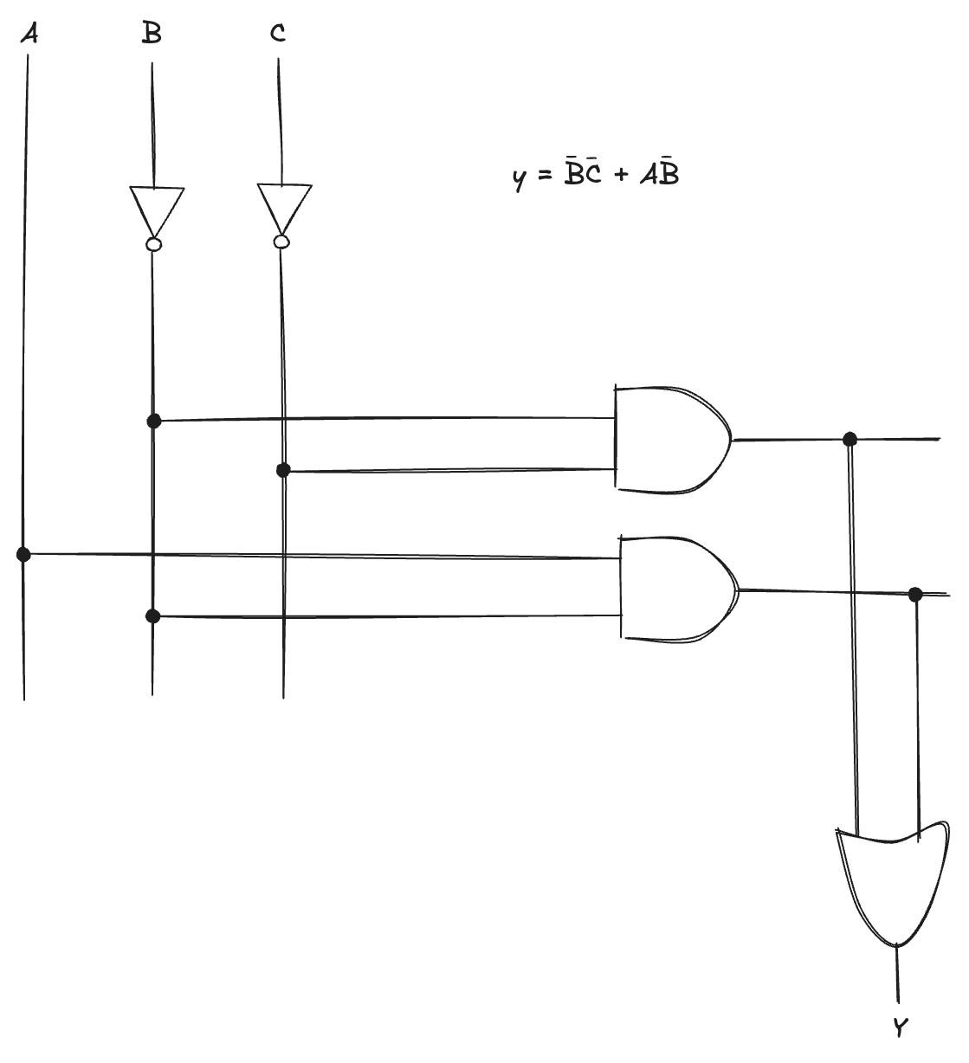
Schematic
A schematic is a diagram of a digital circuit showing the elements and the wires that connect them:
Notice that the simplified circuit has significantly less hardware than that of the original equation, it may be faster because it uses gates with fewer inputs

Slide 22
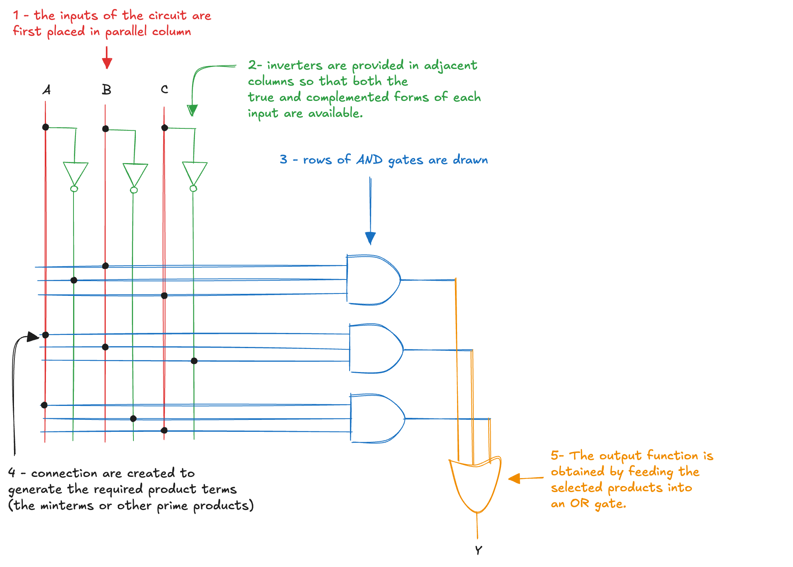
Programmable Logic Array
Any Boolean equation in SOP form can be drawn in a systematic way:
This style is called a Programmable Logic Array (PLA)

Slide 23
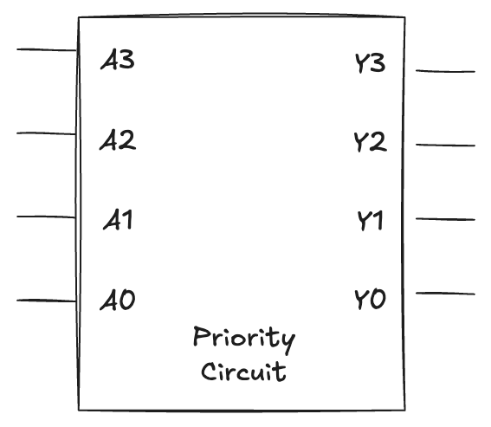
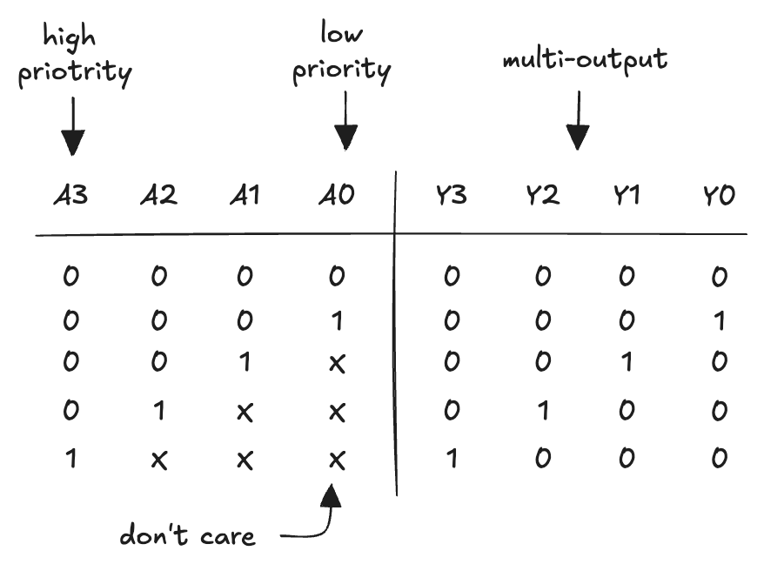
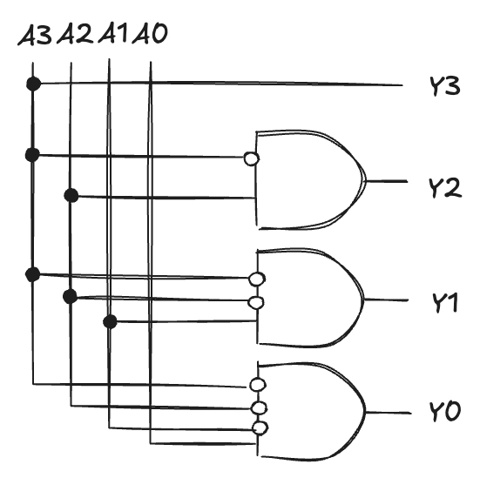
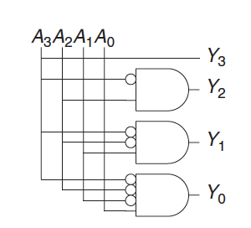
Multiple-output Circuits
Many circuits have multiple outputs
each computes a separate boolean function of the inputs
we can write a separate truth table for each output
or write all the outputs on a single truth table
Example: priority circuit
multiple inputs may be active at the same time, but only the highest-priority active input is recognized and produces the corresponding output
We can use SOP form and reduce the equations using Boolean algebra
However, experienced designer often implement a logic circuit by inspection
notice that if A₃ is 1, the outputs don’t care (X) what the other inputs are

Slide 24
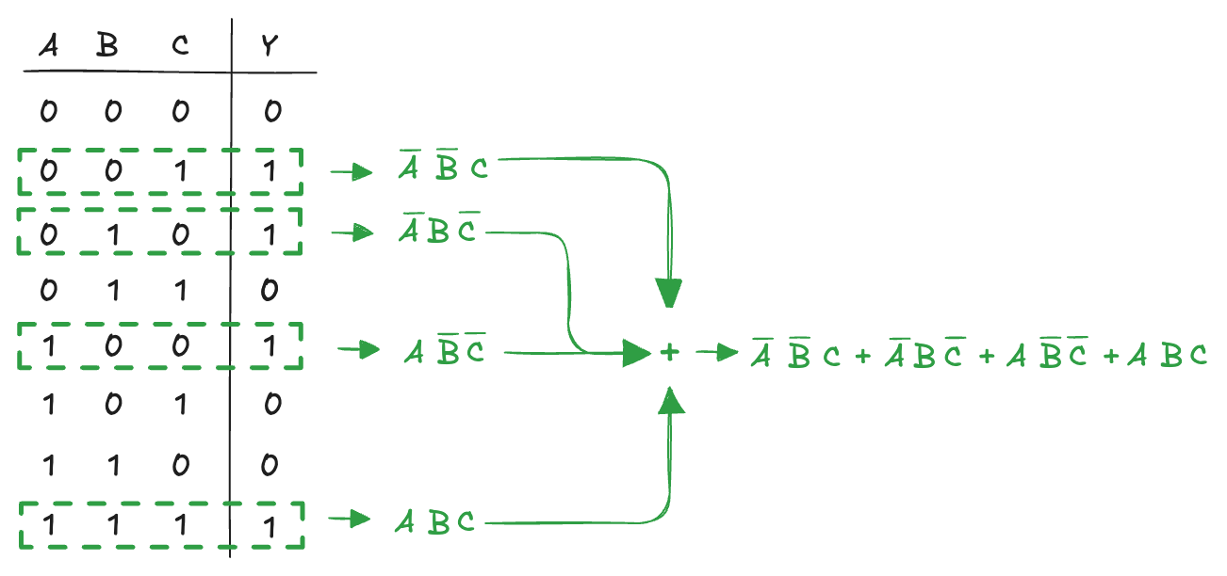
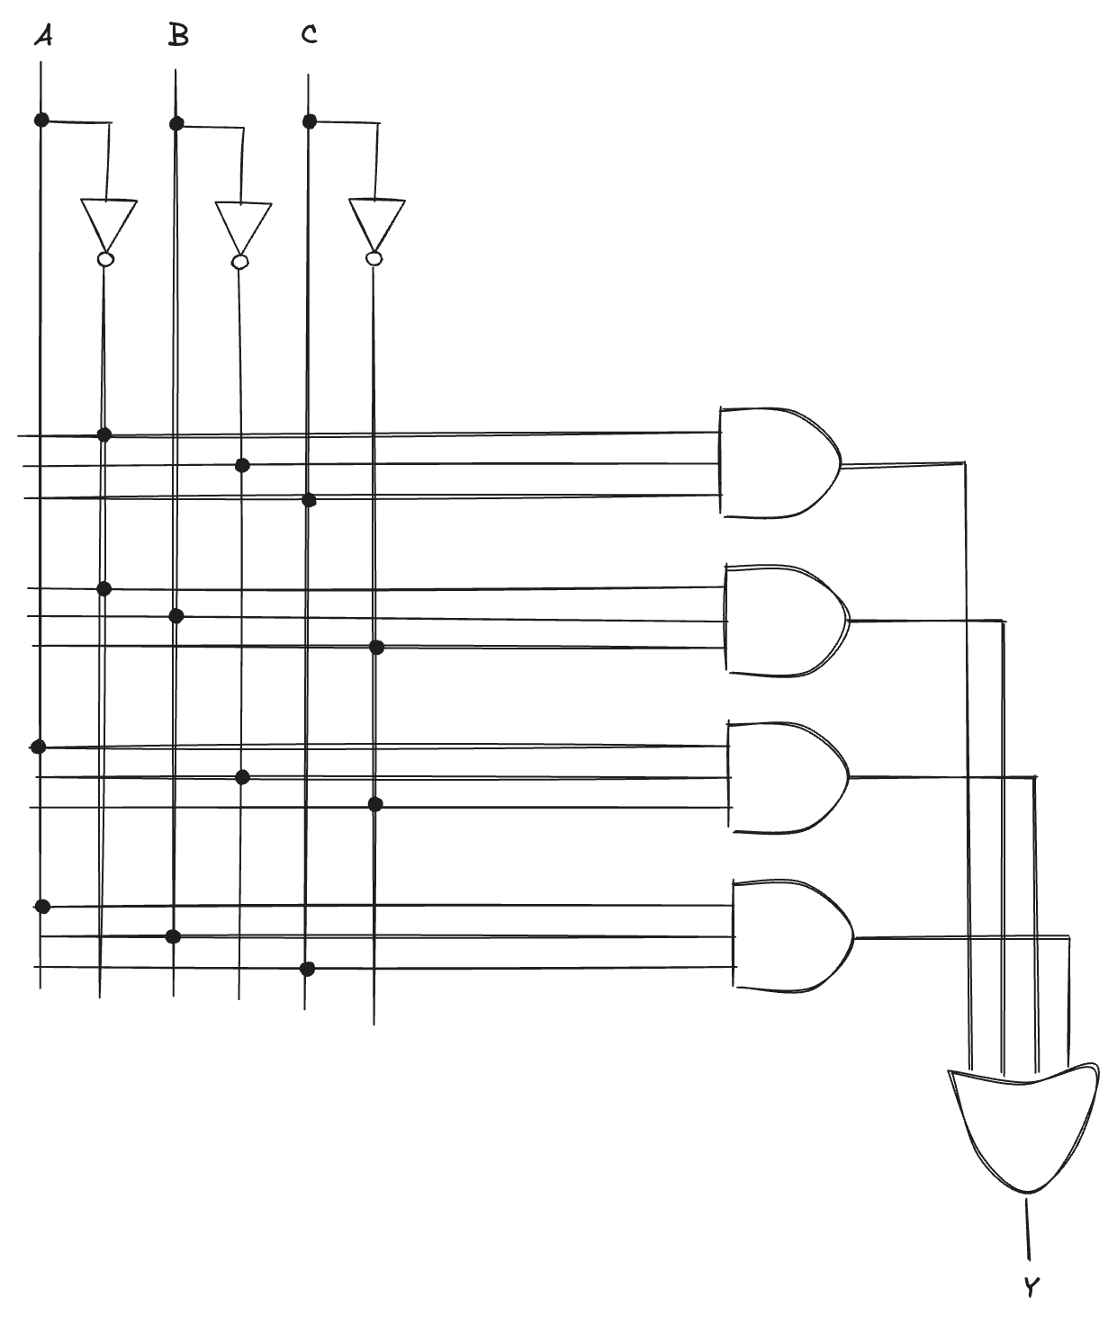

Multilevel Combinational Logic (1)
Logic in sum-of-products form is called two-level logic
it consists of literals connected to a level of AND gates connected to a level of OR gates
some logic functions require an enormous amount of hardware
Multilevel logic: by reorganizing expressions into multiple levels, we can obtain simpler circuits, with fewer gates, reduced hardware cost compared to their two-level counterparts
Example: the XOR function of multiple variables
consider building a three-input XOR using the two-level techniques
an N-input XOR produces a TRUE output when an odd number of inputs are TRUE
On the other hand, notice that:

Slide 25
Multilevel Combinational Logic (2)
Designers often build circuits with more than two levels of logic gates
may use less hardware
However, selecting the best multilevel implementation of a specific logic function is not a simple process: “best” has many meanings
fewest gates, fastest, shortest design time, least cost, least power consumption, etc..
“best” circuit in one technology is not necessarily the best in another
e.g. CMOS circuits prefer NANDs and NORs over ANDs and ORs
With some experience, you will find that you can create a good multilevel design by inspection for most circuits
Computer-Aided Design (CAD) tools are also available to search a vast space of possible multilevel designs and seek the one that fits our constraints given the available building blocks

Slide 26
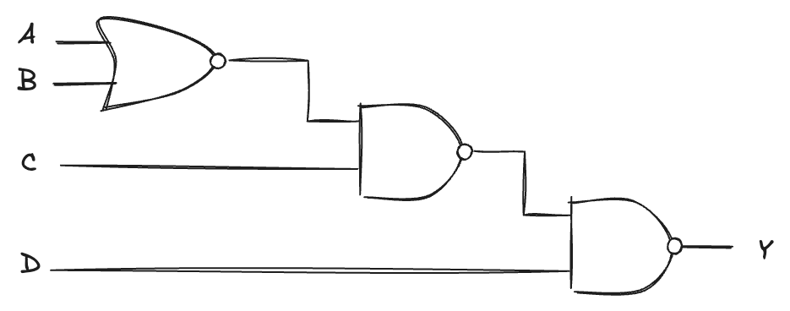

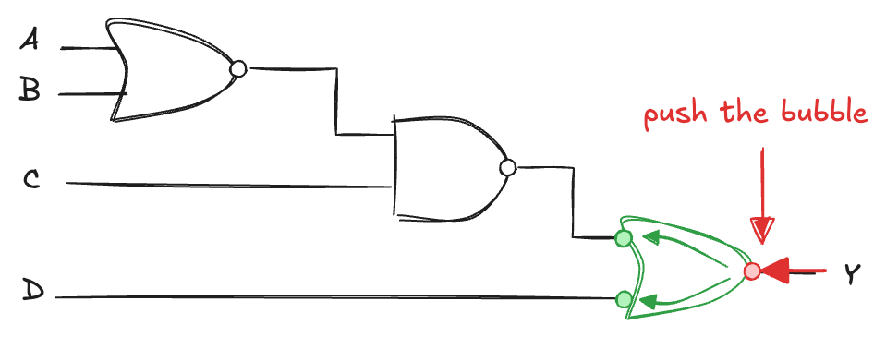
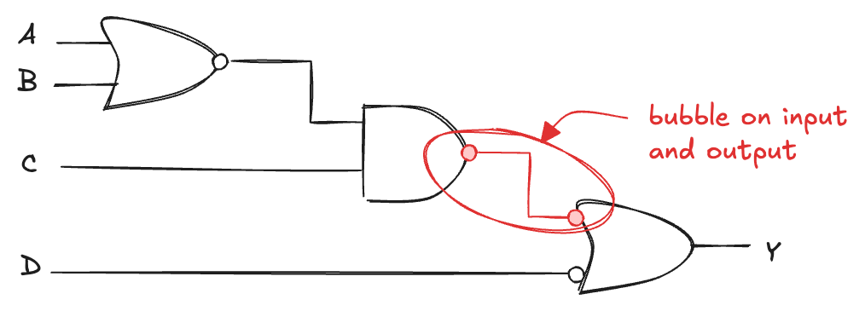
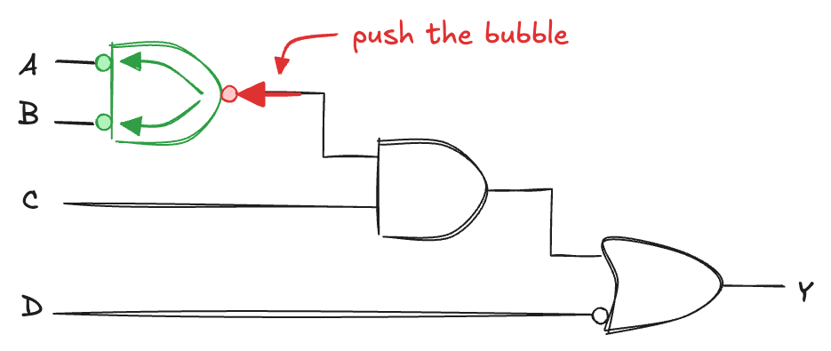
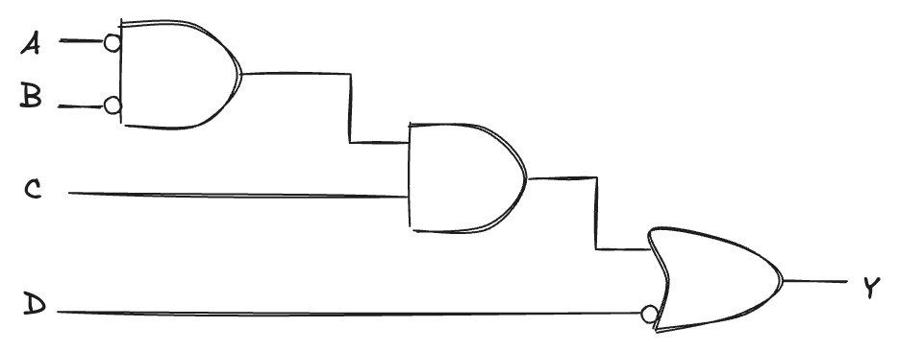

Bubble Pushing
When working with implementations based on NAND and NOR gates, it is often useful to redraw a circuit in a form where the underlying function can be determined more easily:
Redraw circuits using bubble pushing:

Slide 27
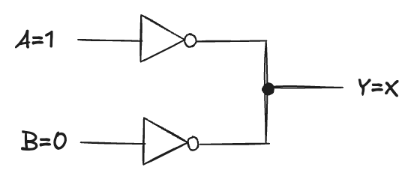
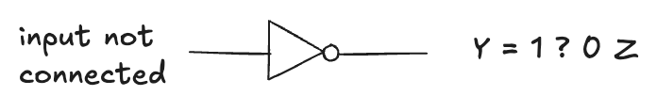
Beyond 0 and 1: X and Z
Boolean algebra is limited to 0 and 1, real circuits can also have illegal and floating values
X (Unknown / Illegal value)
appears when a node is driven simultaneously to 0 and 1 (contention, error condition).
actual voltage may lie between 0 and VDD, depending on gate strengths
also used in simulators for uninitialized values
⚠️ In truth tables, X can also mean “don’t care” → don’t confuse the two
Z (High Impedance / Floating)
node is not driven HIGH or LOW → left floating.
misconception: floating ≠ logic 0. It may be 0, 1, or in between.
common cause: unconnected inputs
floating inputs make circuits erratic; even body static can flip them
sometimes circuits seem to “work” only if a student keeps a finger on a chip…

